Slide 1
Module 5: Make portals with Power Apps

Slide 2
Power Apps portals
Power Apps portals architecture
Access Microsoft Dataverse in Power Apps portals
Authentication and user management in Power Apps portals

Slide 3
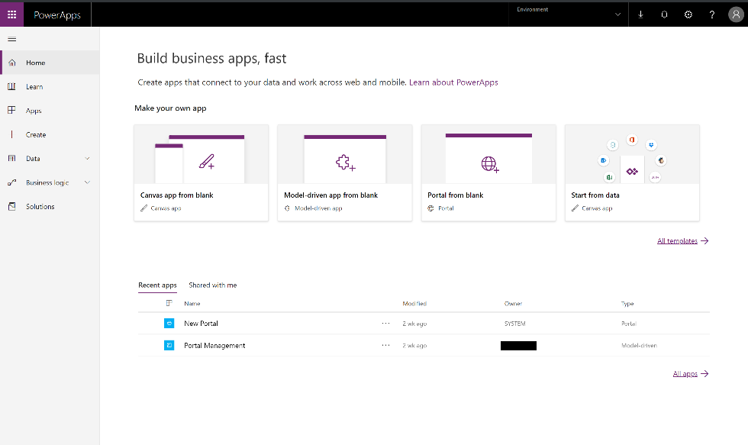
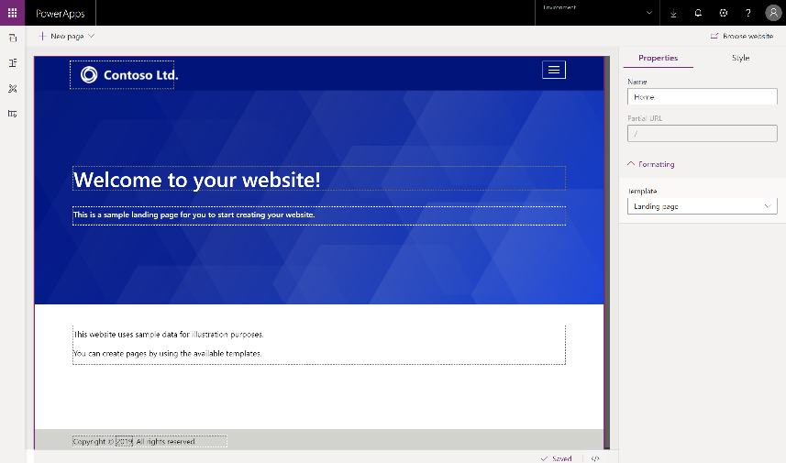
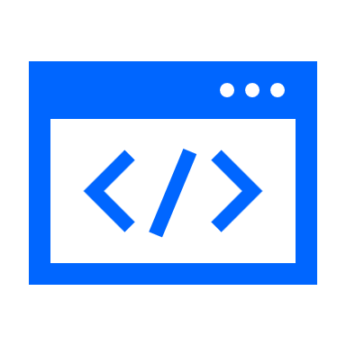
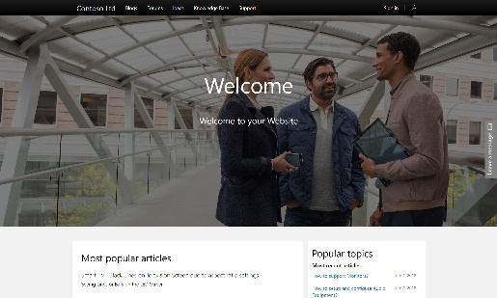
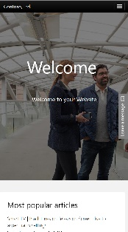

Power Apps Portal – What is it?
Low code solution for creating multilingual, responsive websites for users external to your organizations as well as internal employees.
Use any of the commercial or enterprise login providers like Azure AD B2C, Microsoft Account, LinkedIn, etc. or even allow anonymous access.
Use WYSIWYG designer to create website content and enrich with Microsoft Dataverse data using familiar constructs like forms, views, charts, dashboards.
Pro dev extensibility and templating capabilities to address complex business processes.
Use prebuilt templates like Customer Self Service, Partner Management, Community Self Service or create your own portal. **requires Dynamics subscription**

Slide 4

Demo

Slide 5

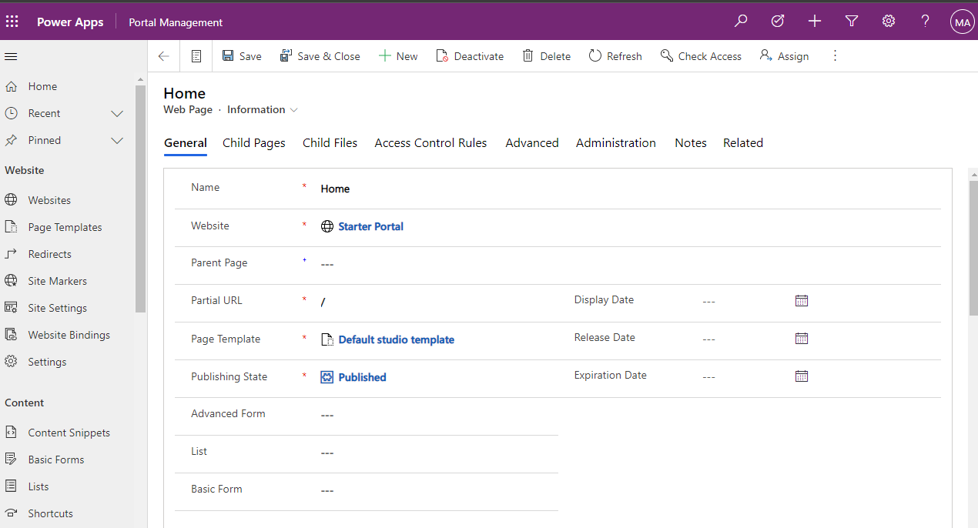
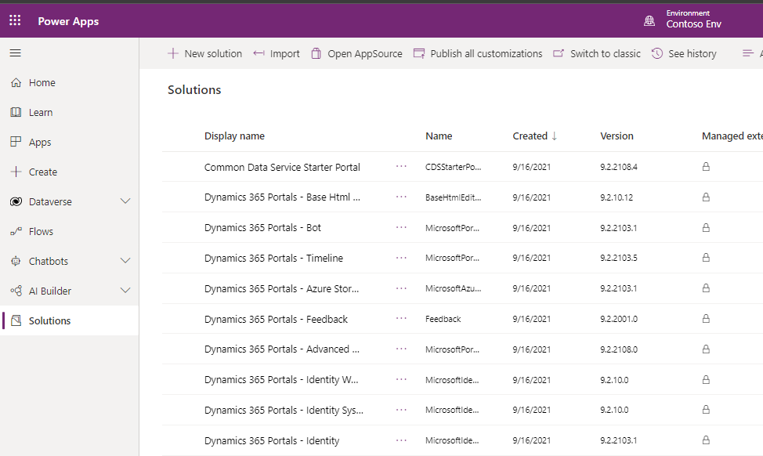
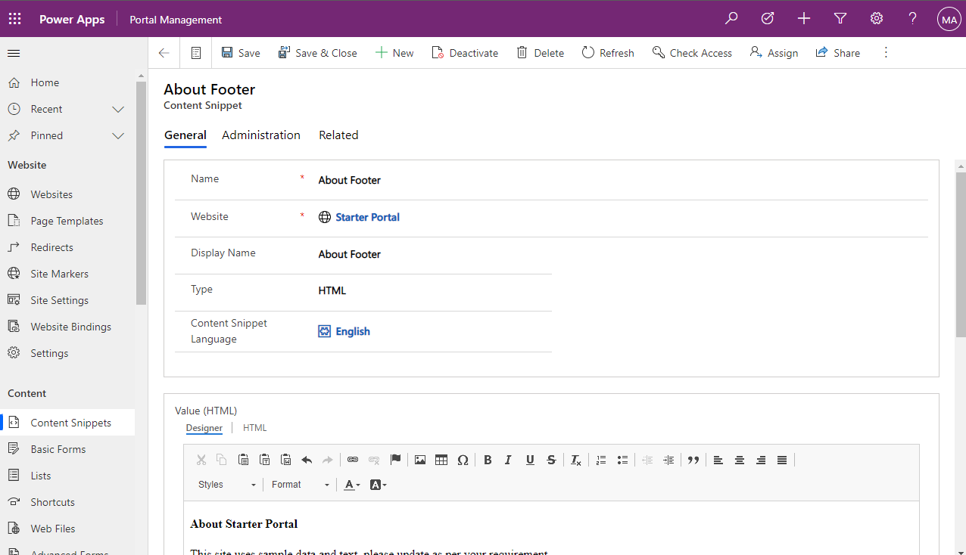
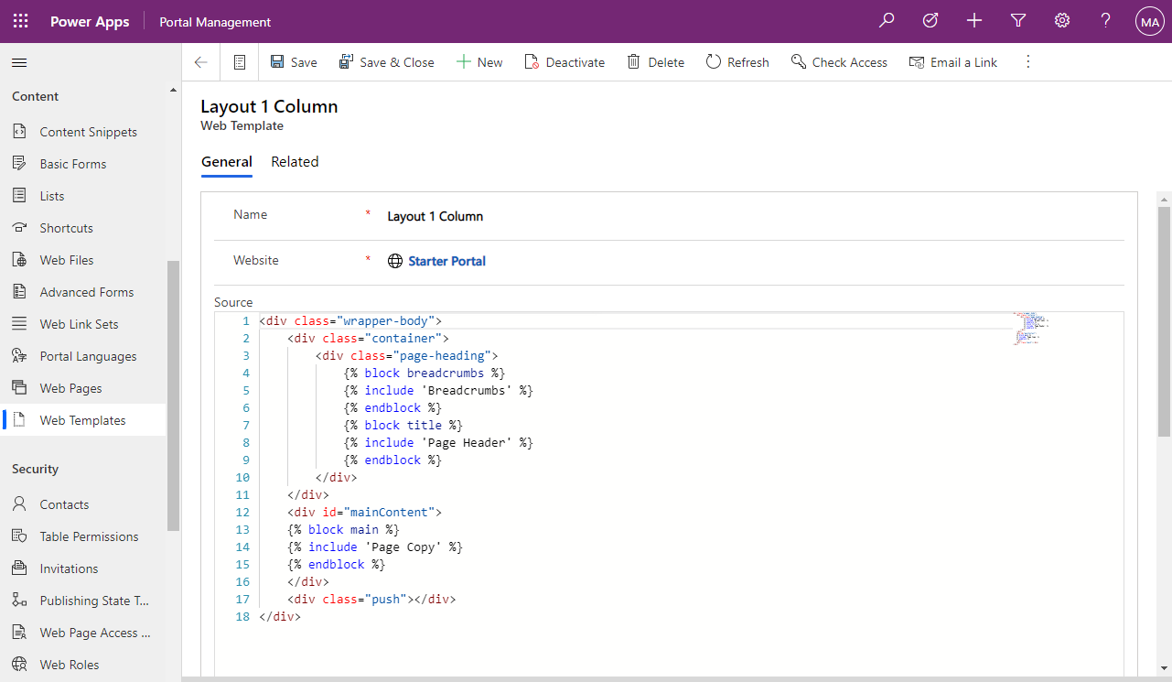
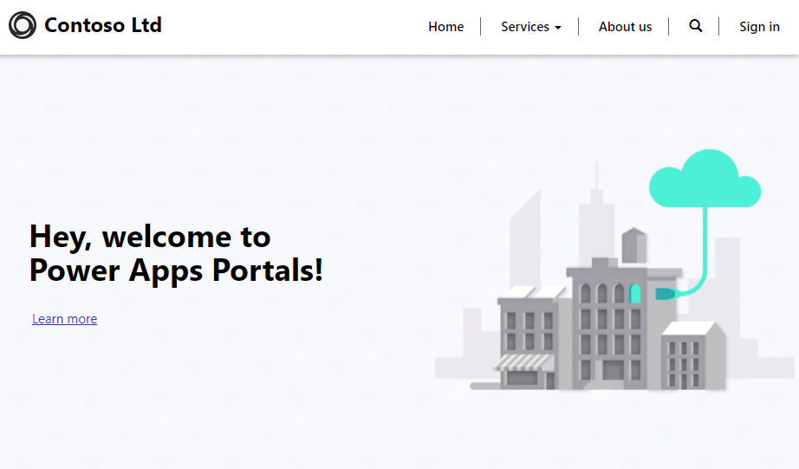
Power Apps Portals Components
Dataverse
Power Apps Portals Solutions
Power Apps Portals Metadata
Power Apps Portals
Web Application

Slide 6
Power Apps Portals Solutions
Numerous Dataverse solutions are installed in the environment.

Slide 7
Power Apps Portals Metadata
Power Apps portal metadata will describe the portal website, webpages, web templates, content snippets, basic forms, advanced forms, lists, site settings, and other configuration data.

Slide 8
Power Apps Portals Web Application
A Microsoft Azure web app is configured to run the portal site by using the portal solutions and metadata.

Slide 9
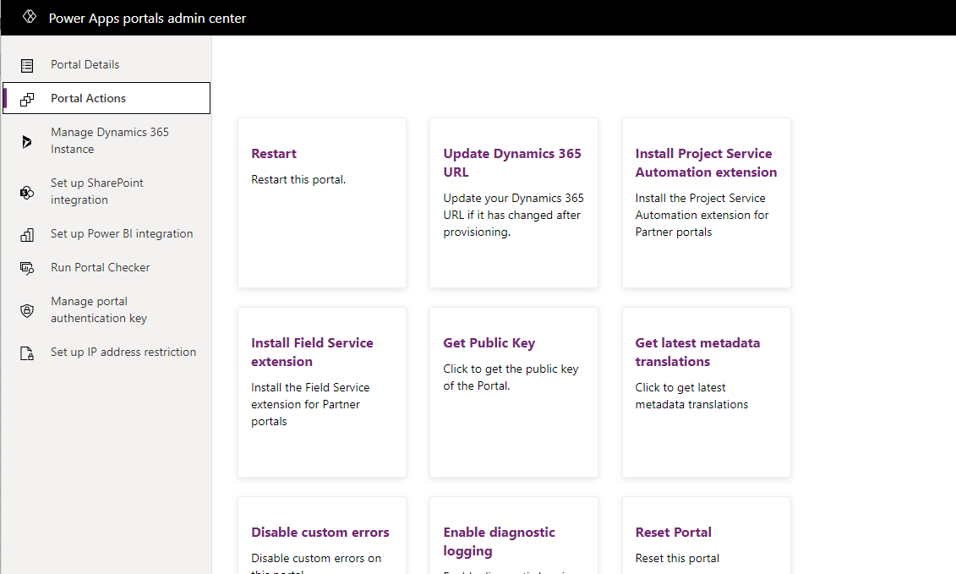
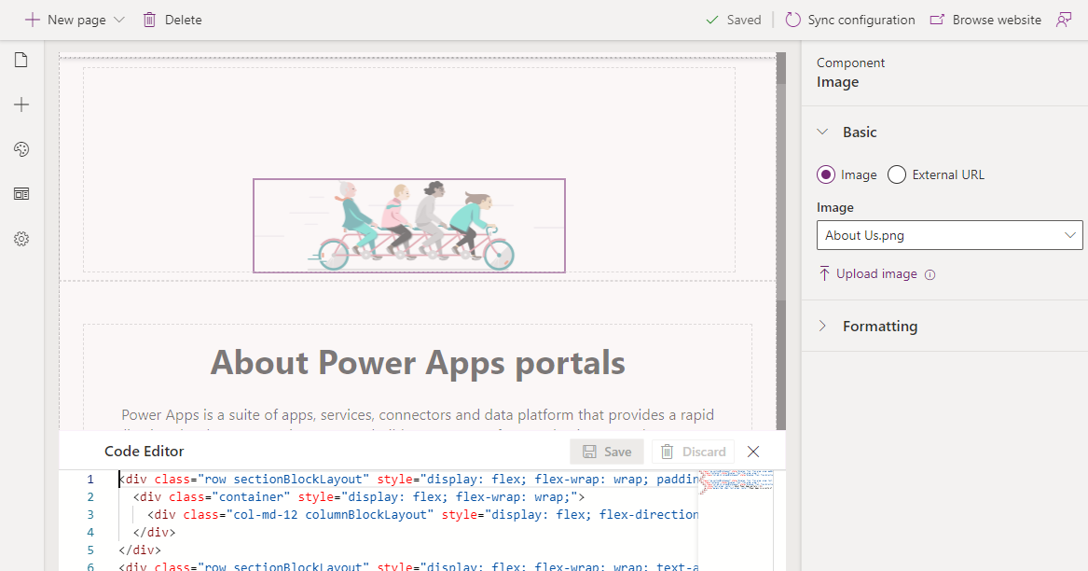
Power Apps Portals Tools
Power Apps Portals admin center
Portal Management app
Power Apps Portals design studio

Slide 10
Power Apps Portals admin center
The Power Apps Portals admin center provides a series of functions for administration of a Power Apps portal such as configuring custom URLs, enabling diagnostic logging, or to enable or install specific features such as SharePoint or Power BI.

Slide 11
Portal Management app
Not all portal configuration features are available in the Power Apps portals Studio.
Warning: Incorrectly modifying the portal metadata might have undesirable effects on the operation and appearance of your portal.

Slide 12
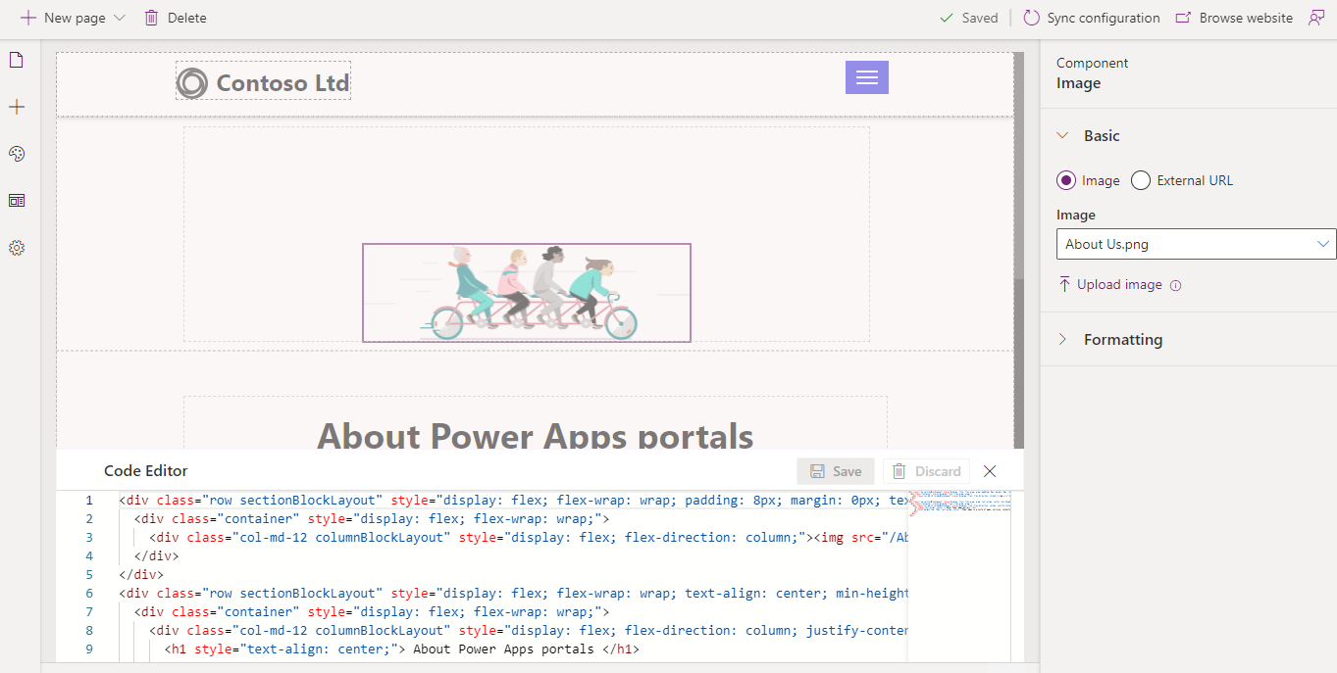
Power Apps Portals design studio
Power Apps portals Studio is a WYSIWYG portal editing tool that allows makers to create and organize webpages, configure page layouts, add portal components, modify CSS, and edit web templates and page source code.
Power Apps portals studio is the safe place to modify portal metadata

Slide 13
Power Apps portals are built on top of Microsoft Dataverse
Common Data Model
Roles and permissions
Forms and views
Business rules
Declarative workflows and actions
Plug-in architecture
Integration with other services
Dataverse extensibility
Audit
Capability | Description
Content | Seamless, responsive, and customizable web design for any user on any device. Full tracking and context are available because Dataverse is the operating system for all interactions.
Functionality | Quickly build more secure, functional websites to interact with Dataverse with no coding required. Track customer interactions across all channels and capture them in a custom Power Apps or Dynamics 365 instance.
Extensibility | Use powerful Microsoft Power Platform business processes that are natively extended through the web front end. Integrate portals with other systems like SharePoint or Power BI. Extend portals with custom development to cater to complex scenarios.
Security | All data that is used to build portal content is protected more through Dataverse security model. Power Apps portals extend this model to help secure and tailor the content for the target audiences who are not Basic Users.

Slide 14

Custom website or portal?

Slide 15
Power Apps portals is a platform and includes a long list of components & features
Content | Extensibility | Security | Functionality
Accessibility | Advanced Forms | Profile Management | Case Deflection
Bootstrap Design | Web Templating | Web Roles | Case Management
Branding | Basic Forms | Invitations | Knowledge Management
Content Publishing | Lists | Content Permissions | Discussion Forums
Responsive Design | Table Actions | Table Permissions | Ideas, Blogs
Webpages | Automation | Identity | Customer, Account, & Opportunity Management
Faceted Search and SEO | Charts & Graphs | Authentication | Delegated Administration
Multilingual Portals | Azure Integration | Auth Providers integration | Multi-Partner Collaboration
Ads, Polls, Ratings, and Comments | SharePoint Integration |  | Entitlements & SLAs
Theming | Power BI Integration |  | Localization into 43 Languages
Web Files | Client-side JavaScript
 | Liquid Templates
 | Web API

Slide 16
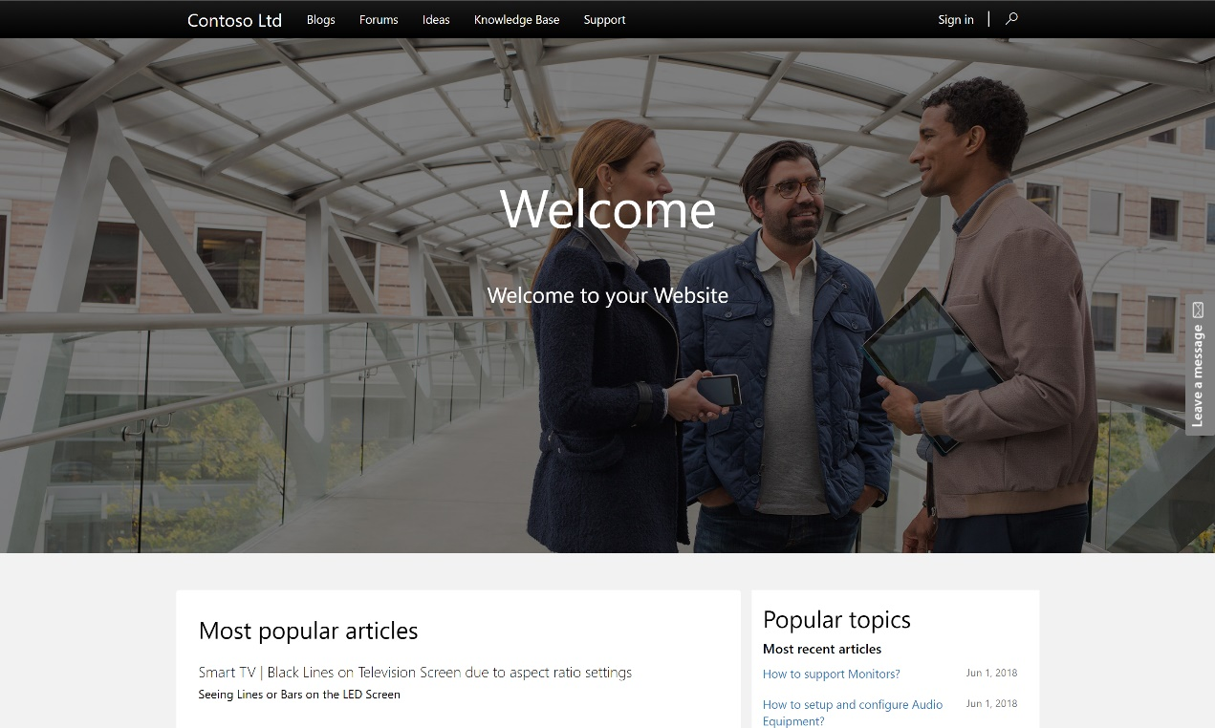
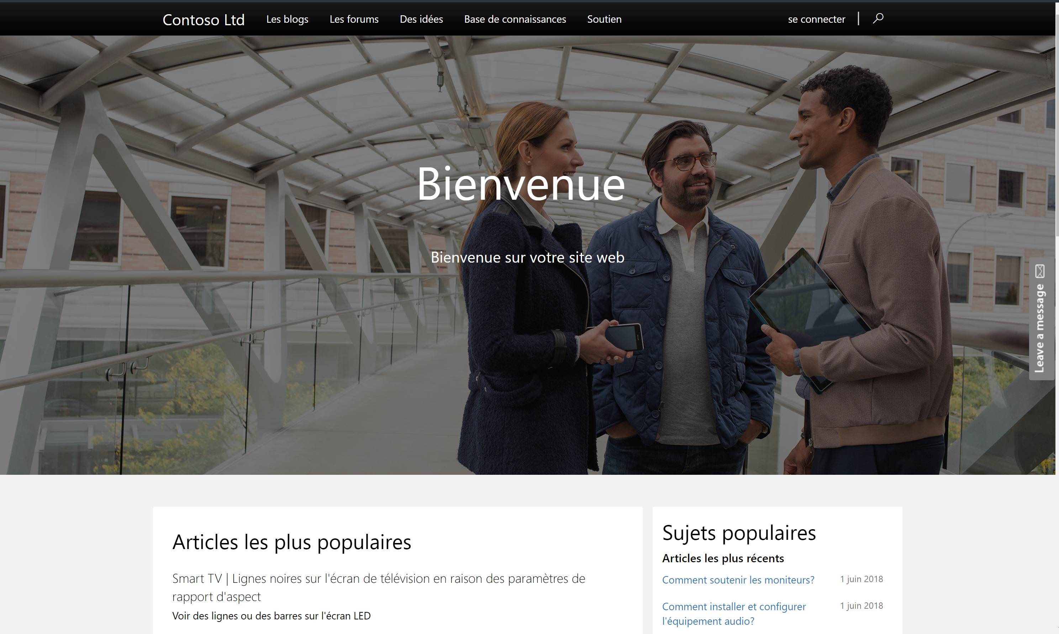
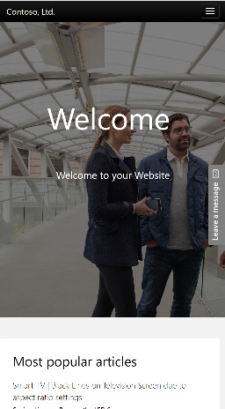
Responsive design
Regardless of how the end-user consumes the portal, the experience responds and sizes appropriately with no additional configuration needed.

Slide 17
Portal provisioning details
To provision a portal, you must be assigned to the System Administrator role of the Dataverse environment that is selected for the portal
A Power Apps portal is not automatically provisioned when a new Dataverse environment is created

Slide 18
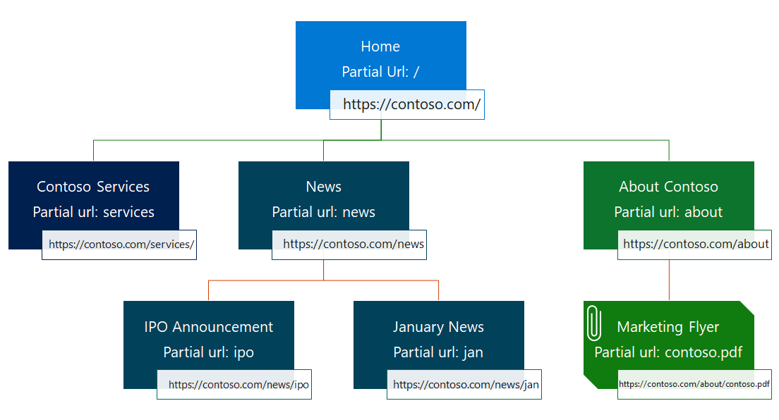
Webpages
Most of a portal's content is represented by webpages.
Portal Studio | Portal Management app
1. Select the portal app and select Edit. | 1. Open the Portal Management app.
2. Select New Page on the Command bar. | 2. Go to Portal > Web Pages.
3. Choose a layout. | 3. Select New.
4. Enter details on the Properties pane. | 4. Enter the page details.
5. The page will be saved automatically. | 5. Select Save.
Security: The user must be a licensed Power Apps user with the appropriate Dataverse security privileges.

Slide 19
Web template
Web templates use the liquid templating language to define how the content is processed and rendered. Can also use HTML, CSS, JavaScript.
Web files
Web files provide access to inline or downloadable content..

Slide 20
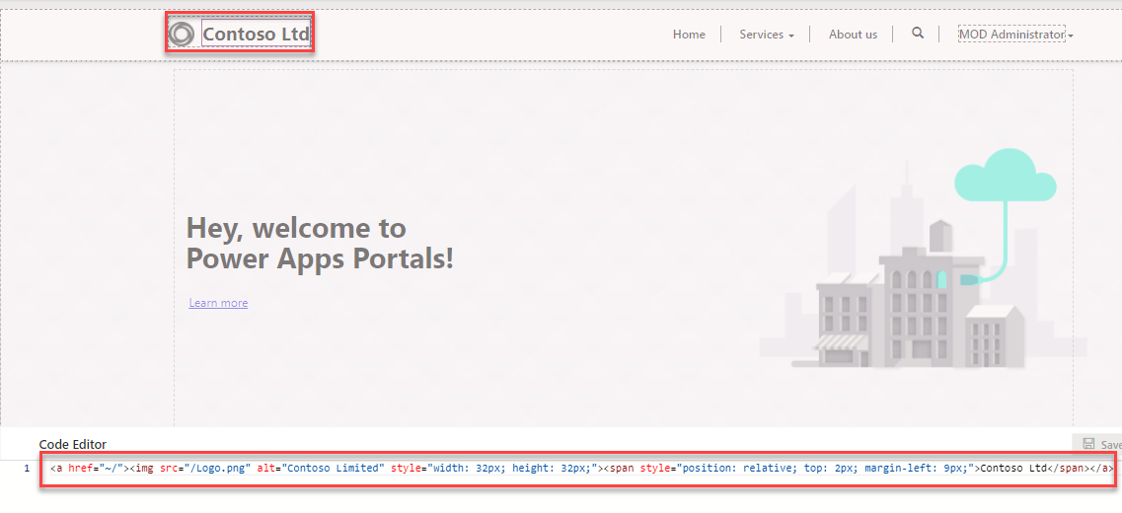
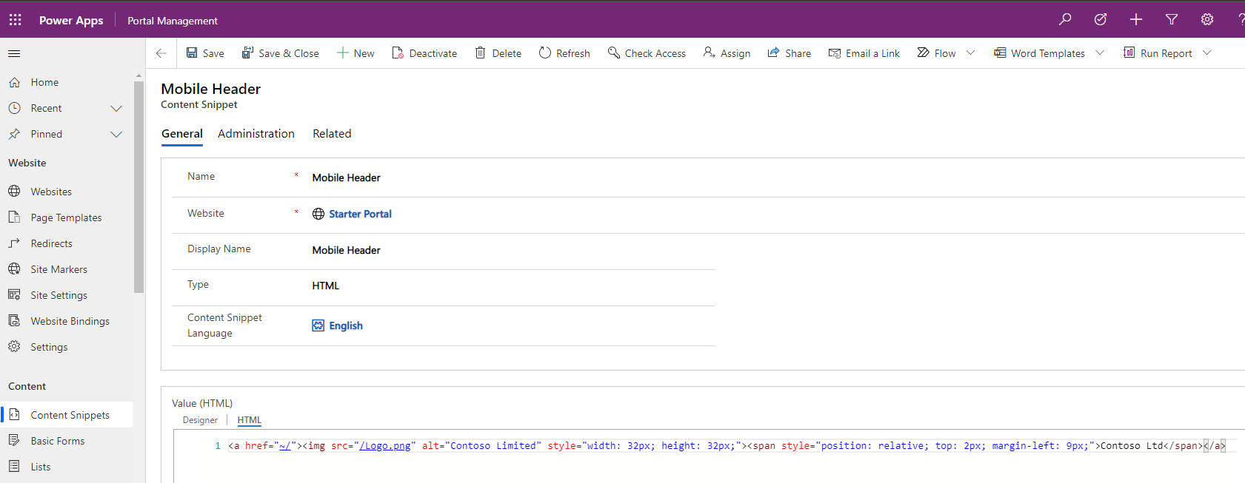
Content snippets
Content snippets are reusable fragments of editable content that can be placed within a web template.

Slide 21
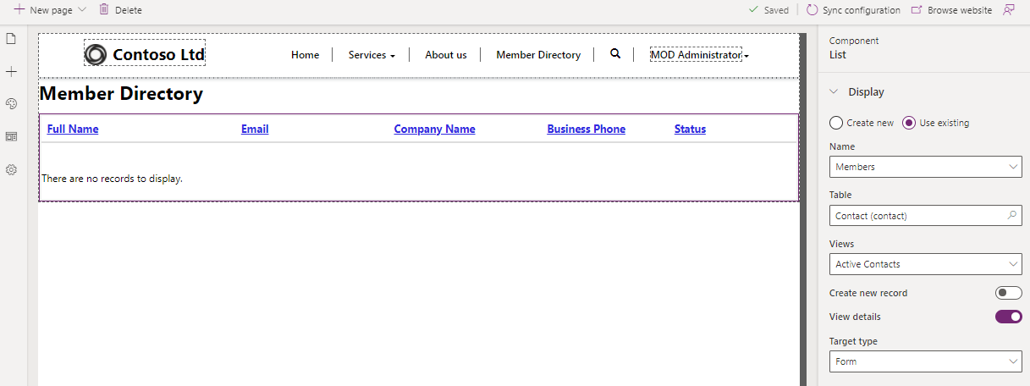
Lists, basic forms, advanced forms
The strength of Power Apps portals is the ability to interact with information and data that is stored in Dataverse.

Slide 22
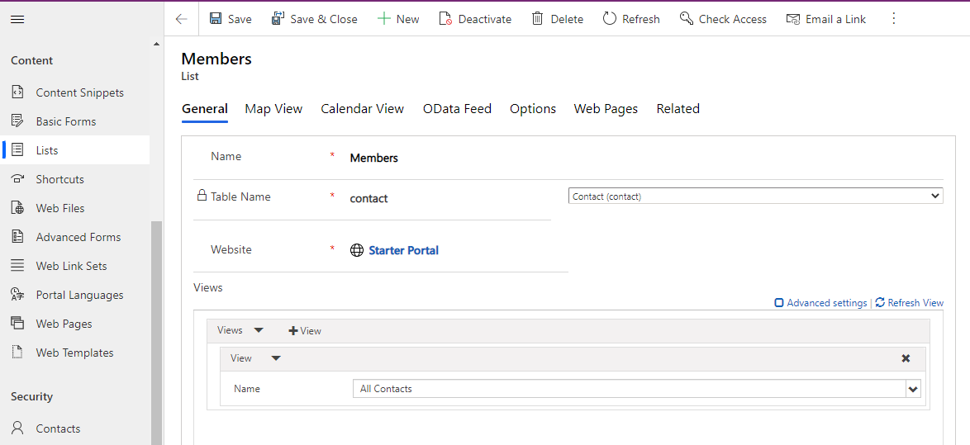
Configure the list
Power Apps portals Studio provides a basic interface for creating and configuring a list

Slide 23
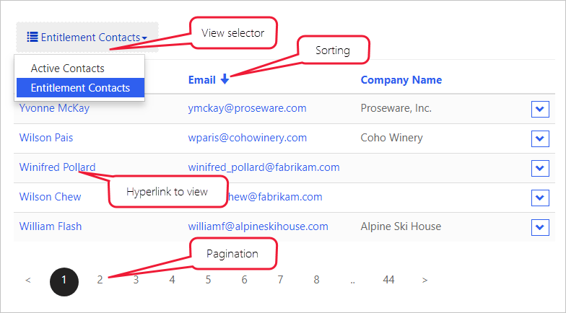
Views
Note: Lists include the Web Page for Details View and Web Page for Create general properties. These properties are for backward compatibility only. The functionality is included as part of the View Actions and Item Actions grid configuration.

Slide 24
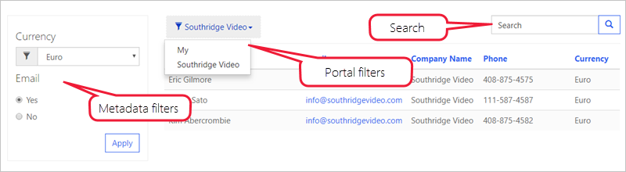
Configuration
List of product reviews that are left by the current user
List of campus buildings for the current user's department (account)
List of all draft pages for the current website, only when multiple portals are provisioned
.

Slide 25
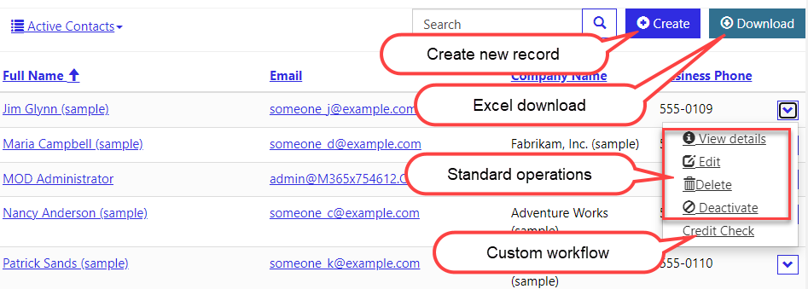
Actions
Lists can have actions associated with them to enable per list commands, like Create and Download (as a Microsoft Excel spreadsheet), or per record commands like View or Edit, and to trigger workflows.

Slide 26
Basic forms
Basic forms add the ability for portal pages to interact with records in a specific table by using a model-driven Power Apps form definition as a layout template.
Informational pages about employees, products, or any other Dataverse table.
Data capture from either anonymous or authenticated users, for example, using a Contact us page to record leads in Dynamics 365 Sales or using a survey page to collect product feedback from customers.
Support pages that provide read-write access to the customers' cases.
Profile self-management for customers.
An alternative user interface for employees that provides required functionality without the need to deploy canvas-based Power Apps.
Any other scenario where data from Dataverse needs to accessed, displayed, captured, and processed by using the portal.

Slide 27
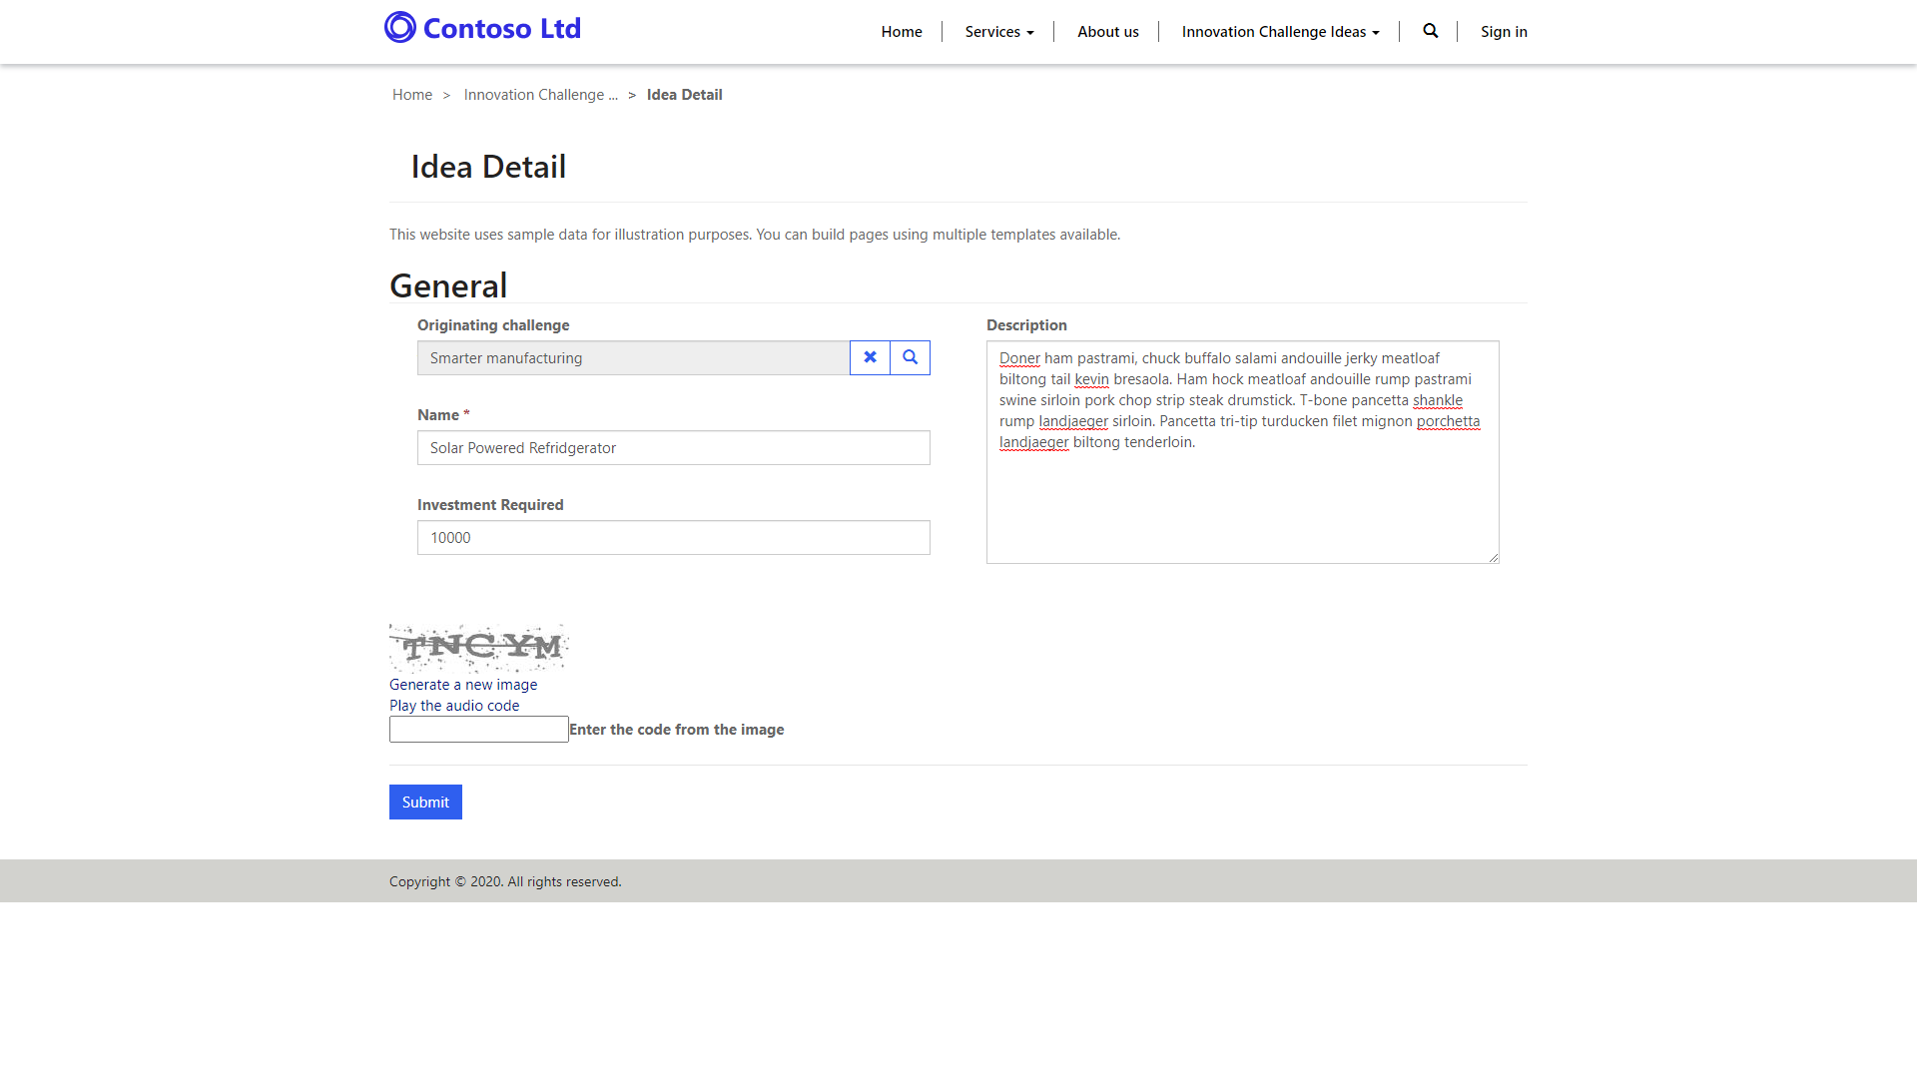
Use basic forms to interact with Microsoft Dataverse data
Basic Forms add the ability for portal pages to interact with records in a specific table by using a model-driven form definition as a layout template.

Slide 28
Common uses
Scenario | Description
Layout | Table forms can be configured and used in read-only mode as a layout mechanism. Think of table forms as informational pages about employees, products, or any other Microsoft Dataverse table. For example, you might have a custom table in your Dataverse instance that describes open positions that are available within your organization. Instead of crafting a special template to render the page, you can create a separate model-driven form for the table, create a new webpage by using portals Studio, and then add a Table Form component to the page. Any published changes in a form layout in a model-driven app will automatically apply to the webpage.
Information capture | Forms can be used on the portal for data capture from anonymous or authenticated users. For example, a simple lead table form might be rendered on a Contact Us page to record anonymous requests as leads in Dynamics 365 Sales. For authenticated users, a portal might use a survey page to collect product feedback from customers into a custom Product Feedback table.
Record management | Typically used in authenticated scenarios, table forms allow various combinations of Create, Retrieve, Update, and Delete (CRUD) operations on a table to be defined within a set of related webpages. For example, customers can retrieve and read their own cases and create new ones, partners can edit their company profiles, and employees can view the list of assets that are allocated to them by the company.
Web apps | Table forms, when used in conjunction with table lists and subgrids, and with the functionality extended by JavaScript, allow developers to build complete web applications.

Slide 29
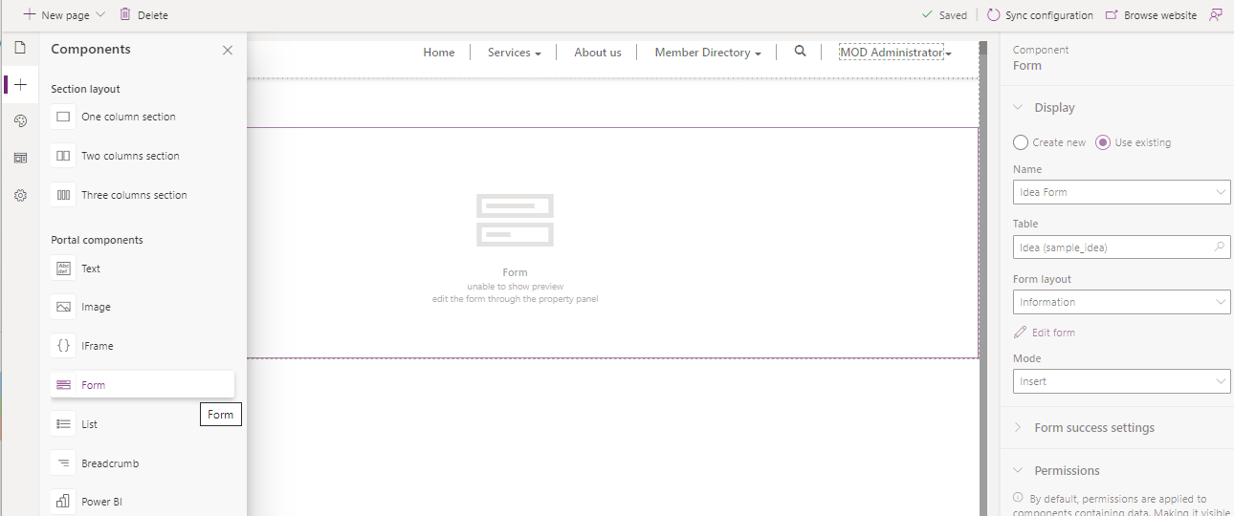
Create a basic form
When creating a new table form, your first step is to decide the Table and Form Name that you will be rendering.
Portal forms are more concise with less information presented, especially when external audiences are involved.
Portal processes are separate from the internal use of a staff-facing, model-driven app (including Dynamics 365 apps). Dedicated portal forms are easier to maintain because any changes in the model-driven apps need to be manually applied to the portal forms, giving you an opportunity to review the requirements and assess usability aspects.
Client-side business rules and JavaScript, which are essential parts of a model-driven form, will not run on the portal. It's easy to overlook and might result in unintended consequences.
Special considerations need to be given when you are rendering related records, notes, and a timeline because not all functional aspects are supported (or required) in the portals.

Slide 30
Form success settings
The form success settings determine the actions that are taken when a form is successfully submitted to a portal.
Show success message - Shows a message when a form is submitted.
Redirect to webpage - Automatically navigates to a webpage on success of the form submission.
Redirect to URL - Redirects to a URL (portal or external).

Slide 31
Basic form metadata
Basic form metadata records allow you to control the appearance and behavior of individual form elements, including:
Appearance of the columns, sections, and tabs. An individual column's default values, validation behavior, and other aspects can be defined.
Subgrids configuration, which allows you to define actions for related records, similar to table list actions.
Behavior of notes and timeline sections, and if new records can be added. This option is commonly used to allow portal users to enter comments about the record, for example, a case in process.

Slide 32
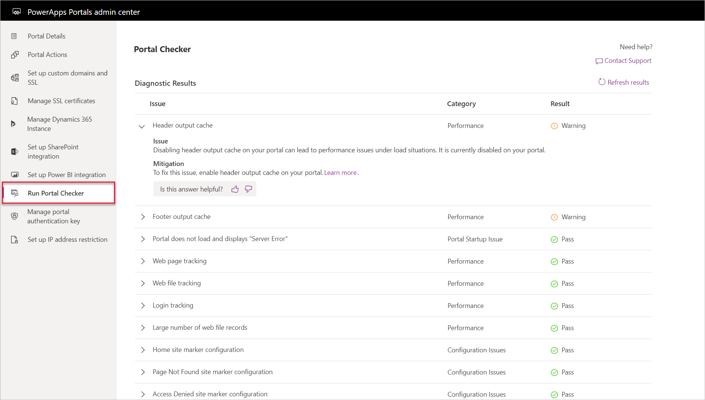
Portal Checker
The Portal Checker feature is available in the Power Apps Portals admin center and will run diagnostic checks to protect and advise against common issues that might be encountered when operating a portal.

Slide 33
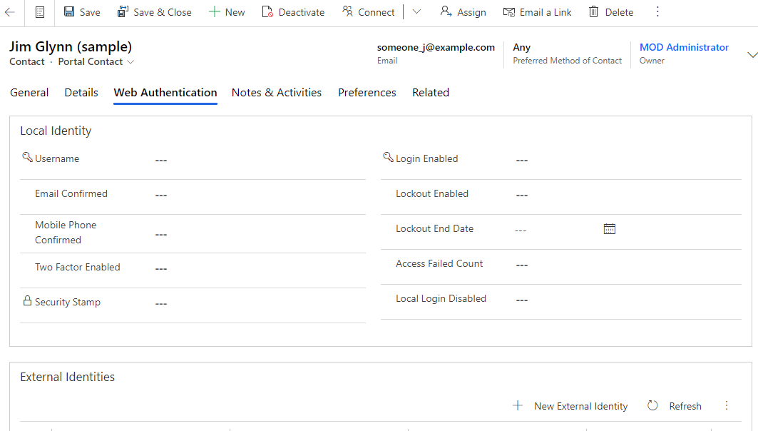
Overview of portal security
Users of Power Apps portals are tracked in Microsoft Dataverse as contacts.

Slide 34
Contact extensions
To support authentication, Power Apps portals extends the Contact entity and adds the External Identity entity.
Control parts of the authentication process, for example, if sign-in is enabled for the contact.
Access portal-specific contact information.
Provide registration and profile management forms for the portal.
Support password-based local authentication.
Enforce password and lockout policies.
Manage user's identities when external providers are used.

Slide 35
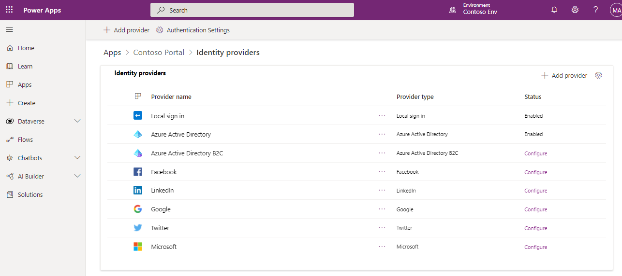
Authentication
Portal users can authenticate by using the following methods:
Local authentication - Common forms-based authentication with usernames and password hashtags are stored in the Dataverse contact record.
External authentication - Credentials and password management are handled by other identity providers. Supported authentication providers include:
OAuth2 (Microsoft, Twitter, Facebook, Google, LinkedIn, Yahoo)
Open ID (Azure Active Directory, Azure Active Directory B2C)
WS-Federation and SAML 2.0. These providers are used for integration with on-premises Active Directory and other identity services.

Slide 36
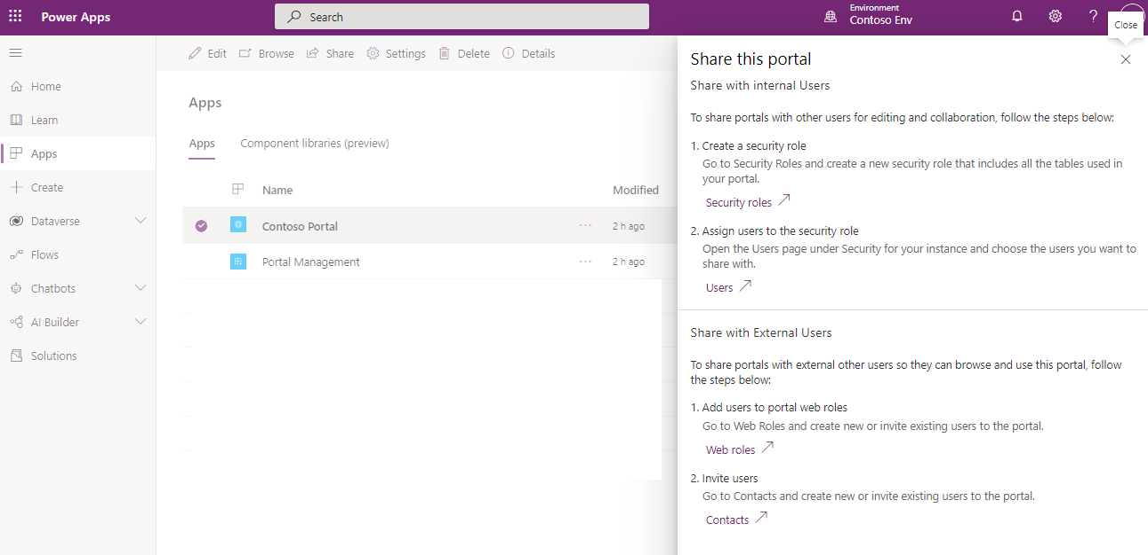
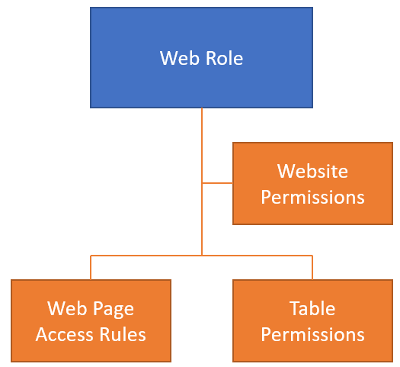
Authorization
After the user is authenticated and associated with a contact, Power Apps portals uses numerous tables to define authorization, that is, what a user is allowed to do.

Slide 37
Overview of extending portals
Power Apps portals is considered a no-code, low-code solution to building portal apps.
Liquid
Web templates
JavaScript
CSS
Portal WebAPI
Companion apps

Slide 38
Summary
Power Apps portals help you engage with additional stakeholders
Portals have several tools available to help you manage content and user access and experience
Portals offer secure access to your data

Slide 39
Closing slide

